Slide 1
Azure AD Configuration Assessment
[MM/DD/YYY]
<Assessor Name>
<Assessor Title>
<Assessor Company Name>
Prepared for: <Customer Name>

Slide 2
Assessment Walk-through
Goals of the assessment
Provide Insights from your own data
Improve Identity and Access Management Posture
Two-way discussion
Findings are based on lessons learned / real world experience across large enterprise customers
We want to learn if/how recommendations fit in your environment and requirements

Slide 3
How we will present results
Assessment Breakdown
Area
Summary
Recommendations

Slide 4
How we will present results
Recommendation Priority
P0: As soon as Possible
P1: Next 30 days
P2: Next 60 days
P3: Later

Slide 5
How we will present results
Collateral
This Slide Deck with Summary and Recommendations
Power BI Model with Data Insights
Detailed AD Sync Configuration Summary

Slide 6
How we will present results
Disclaimers
The recommendations here covers several IAM areas, but there is no warranty of absolute coverage
The recommendations here are current as of the date of this engagement. This changes constantly, and customers should be continuously evaluating their IAM practices as Microsoft products and services evolve over time
The recommendations here are provided based on the data provided during the interview, and telemetry.

Slide 7
Executive Summary
Disable Legacy Authentication
Deploy Password Protection
ADFS Health Connect Agent
Application Overview
Deploy Privileged Identity Management

Slide 8
Identity Management

Slide 9
Identity Management
Summary
[Highlights of what you found]
[Call out good practices]
Notes:
Delivery Notes
Use the interview doc to get the list of process w/o owner
Recommendations will be (a) assign owners to tasks

Slide 10


Identity Management
Data Walkthrough
Patterns of Sync Issues
Azure AD Connect Delta Sync Cycle Baseline
Azure AD Connect Config Documenter Output
Notes:
Protecting the organization at the front door, being the first line of defense means that we need to protect access. We need to make sure the right people access my network.
So lets ask a critical question: how much control do organizations have over access?
EMS Overview
© 2014 Microsoft Corporation. All rights reserved. Microsoft, Windows, Surface and other product names are or may be registered trademarks and/or trademarks in the U.S. and/or other countries. The information herein is for informational purposes only and represents the current view of Microsoft Corporation as of the date of this presentation. Because Microsoft must respond to changing market conditions, it should not be interpreted to be a commitment on the part of Microsoft, and Microsoft cannot guarantee the accuracy of any information provided after the date of this presentation. MICROSOFT MAKES NO WARRANTIES, EXPRESS, IMPLIED OR STATUTORY, AS TO THE INFORMATION IN THIS PRESENTATION.
8/20/2021
10

Slide 11
Identity Management
Recommendations
[List of Recommendations, sorted by priority]
Notes:
Delivery Notes
Use the interview doc to get the list of process w/o owner
Recommendations will be (a) assign owners to tasks

Slide 12
Access Management

Slide 13
Access Management
Summary
[Highlights of what you found]
[Call out good practices]
Notes:
Delivery Notes
Use the interview doc to get the list of process w/o owner
Recommendations will be (a) assign owners to tasks

Slide 14

Access Management
Data Walkthrough
Programmatic Usage of Credentials
Single Sign-On for apps
Migration of AD FS Applications to Azure AD
Consent Grants
Notes:
Protecting the organization at the front door, being the first line of defense means that we need to protect access. We need to make sure the right people access my network.
So lets ask a critical question: how much control do organizations have over access?
EMS Overview
© 2014 Microsoft Corporation. All rights reserved. Microsoft, Windows, Surface and other product names are or may be registered trademarks and/or trademarks in the U.S. and/or other countries. The information herein is for informational purposes only and represents the current view of Microsoft Corporation as of the date of this presentation. Because Microsoft must respond to changing market conditions, it should not be interpreted to be a commitment on the part of Microsoft, and Microsoft cannot guarantee the accuracy of any information provided after the date of this presentation. MICROSOFT MAKES NO WARRANTIES, EXPRESS, IMPLIED OR STATUTORY, AS TO THE INFORMATION IN THIS PRESENTATION.
8/20/2021
14

Slide 15
Access Management
Recommendations
[List of Recommendations, sorted by priority]
Notes:
Delivery Notes
Use the interview doc to get the list of process w/o owner
Recommendations will be (a) assign owners to tasks

Slide 16
Governance

Slide 17
Governance
Summary
[Call out good practices]
[Highlights of what you found]
Notes:
Delivery Notes
Use the interview doc to get the list of process w/o owner
Recommendations will be (a) assign owners to tasks

Slide 18
Governance
Privileged Accounts Usage
Notes:
Protecting the organization at the front door, being the first line of defense means that we need to protect access. We need to make sure the right people access my network.
So lets ask a critical question: how much control do organizations have over access?
EMS Overview
© 2014 Microsoft Corporation. All rights reserved. Microsoft, Windows, Surface and other product names are or may be registered trademarks and/or trademarks in the U.S. and/or other countries. The information herein is for informational purposes only and represents the current view of Microsoft Corporation as of the date of this presentation. Because Microsoft must respond to changing market conditions, it should not be interpreted to be a commitment on the part of Microsoft, and Microsoft cannot guarantee the accuracy of any information provided after the date of this presentation. MICROSOFT MAKES NO WARRANTIES, EXPRESS, IMPLIED OR STATUTORY, AS TO THE INFORMATION IN THIS PRESENTATION.
8/20/2021
18

Slide 19
Governance
Recommendations
[List of Recommendations, sorted by priority]
Notes:
Delivery Notes
Use the interview doc to get the list of process w/o owner
Recommendations will be (a) assign owners to tasks

Slide 20
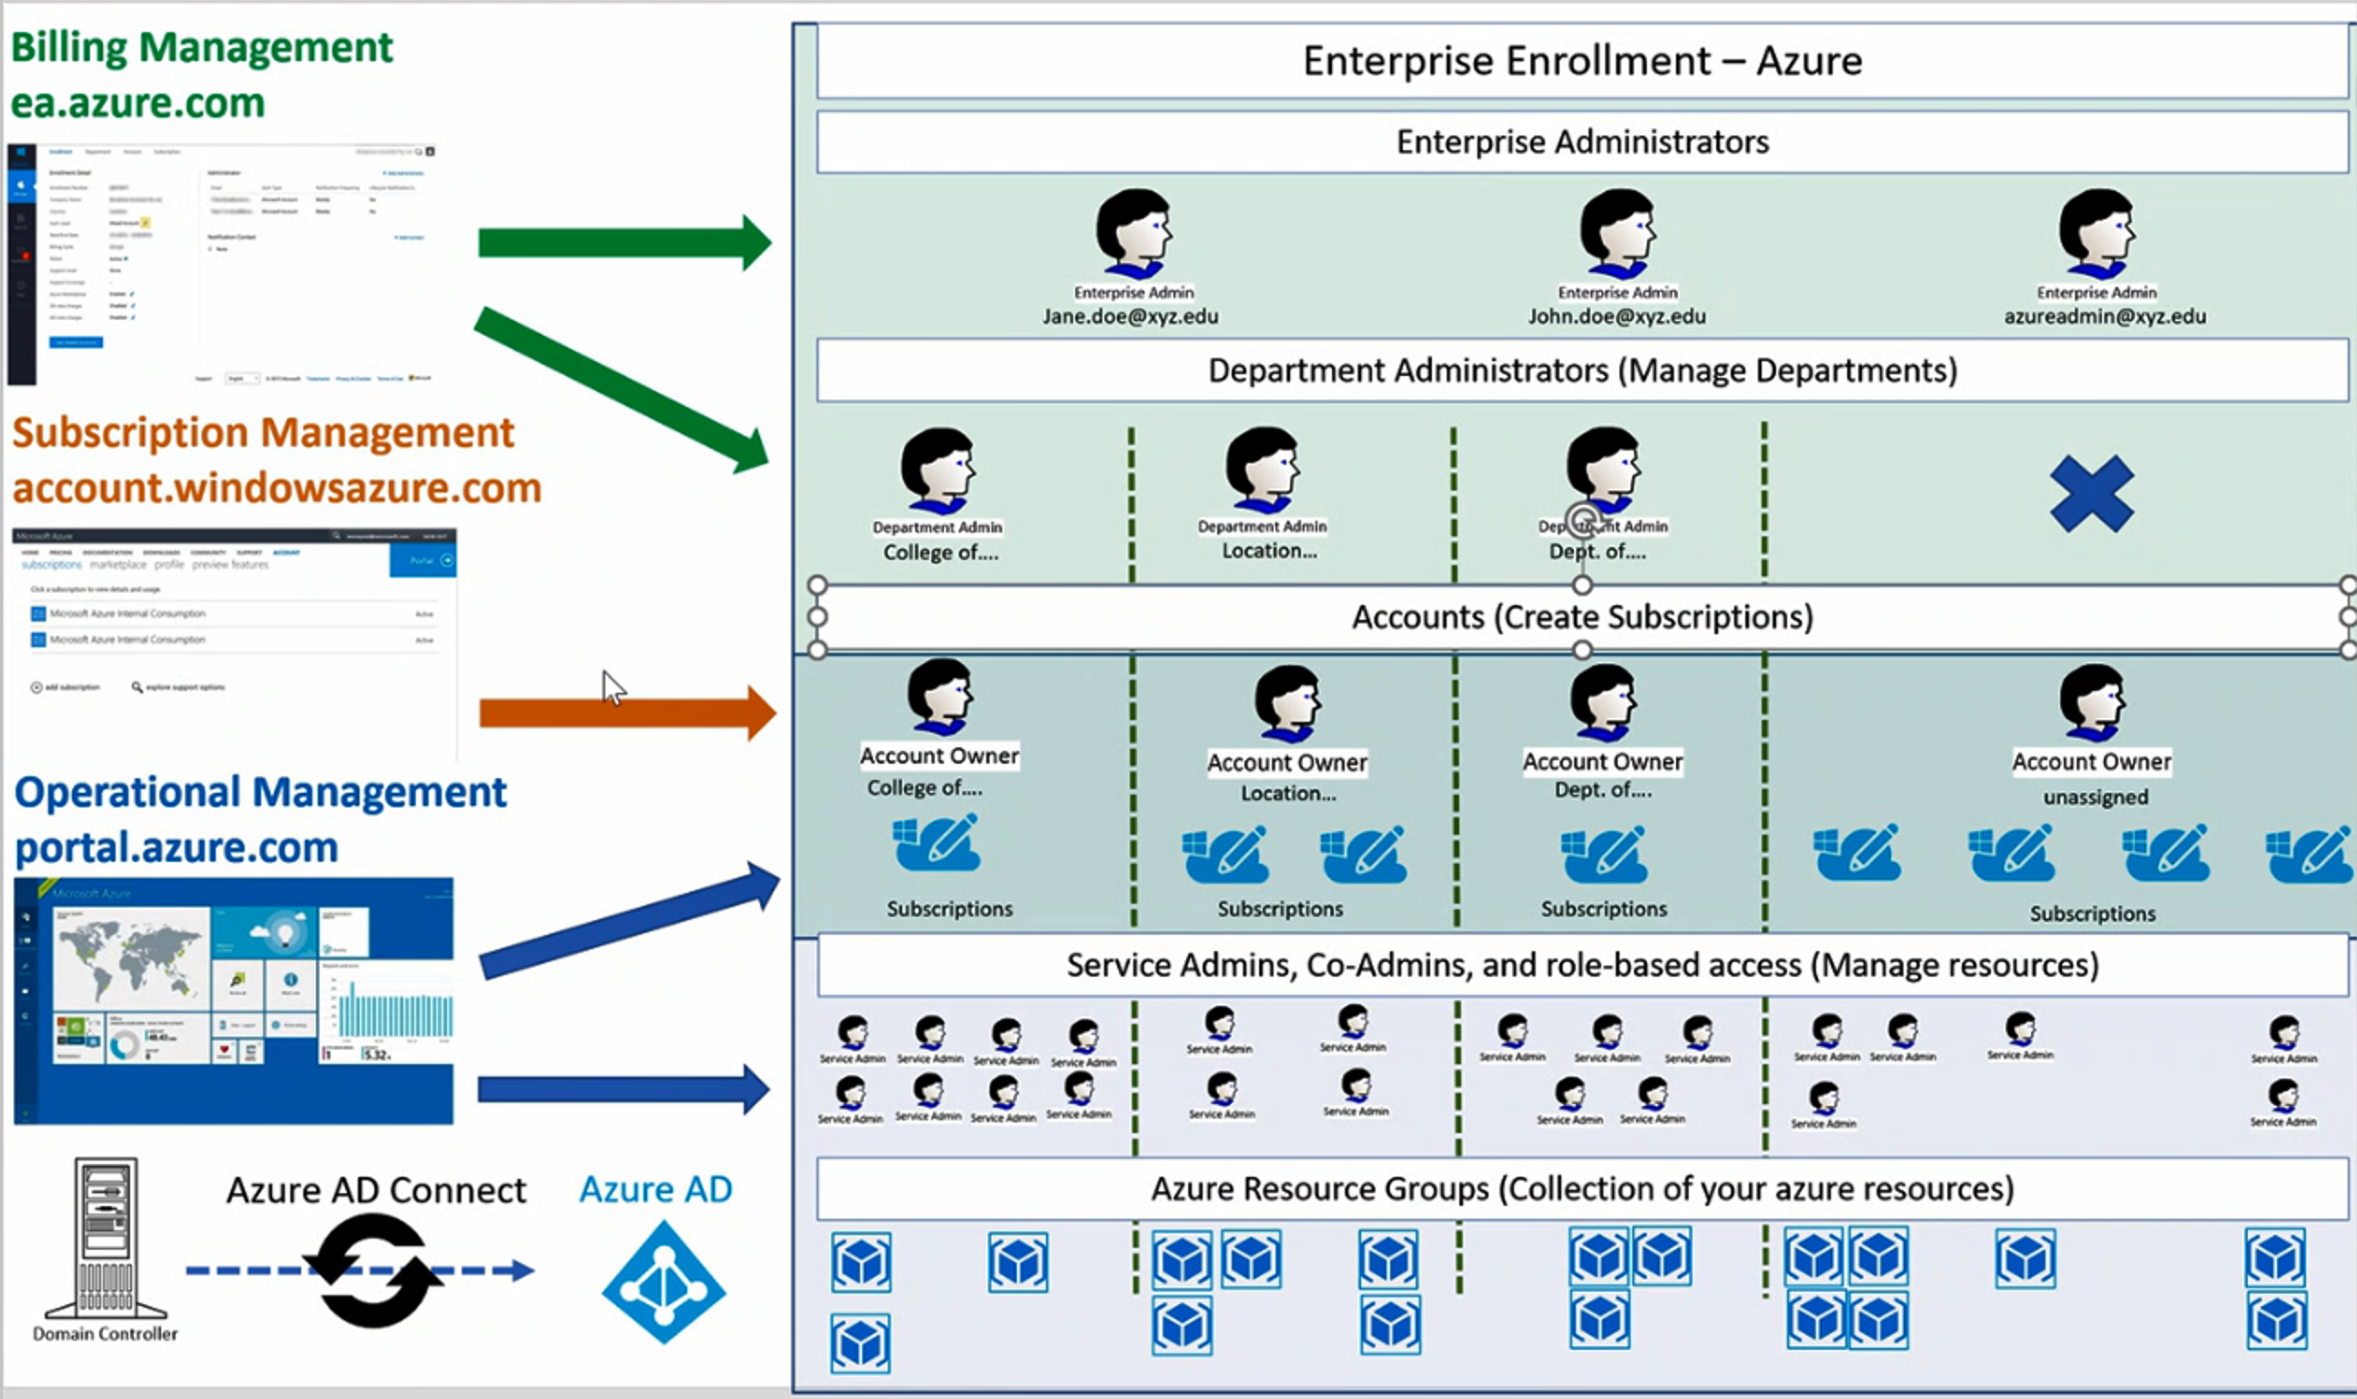
Outcome: Surface Area Reduction

Slide 21
Operations

Slide 22
Operations
Summary
[Highlights of what you found]
Good license management
Notes:
Delivery Notes
Use the interview doc to get the list of process w/o owner
Recommendations will be (a) assign owners to tasks

Slide 23

Operations
Data Walkthrough
Privileged Accounts Usage
Recent versions of On-Premises Components
Azure AD Connect Health Alert Baseline
E-mail notifications are configured correctly
Notes:
Protecting the organization at the front door, being the first line of defense means that we need to protect access. We need to make sure the right people access my network.
So lets ask a critical question: how much control do organizations have over access?
EMS Overview
© 2014 Microsoft Corporation. All rights reserved. Microsoft, Windows, Surface and other product names are or may be registered trademarks and/or trademarks in the U.S. and/or other countries. The information herein is for informational purposes only and represents the current view of Microsoft Corporation as of the date of this presentation. Because Microsoft must respond to changing market conditions, it should not be interpreted to be a commitment on the part of Microsoft, and Microsoft cannot guarantee the accuracy of any information provided after the date of this presentation. MICROSOFT MAKES NO WARRANTIES, EXPRESS, IMPLIED OR STATUTORY, AS TO THE INFORMATION IN THIS PRESENTATION.
8/20/2021
23

Slide 24
Operations
Recommendations
[List of Recommendations, sorted by priority]
Notes:
Delivery Notes
Use the interview doc to get the list of process w/o owner
Recommendations will be (a) assign owners to tasks

Slide 25
Questions?

